Slide 1
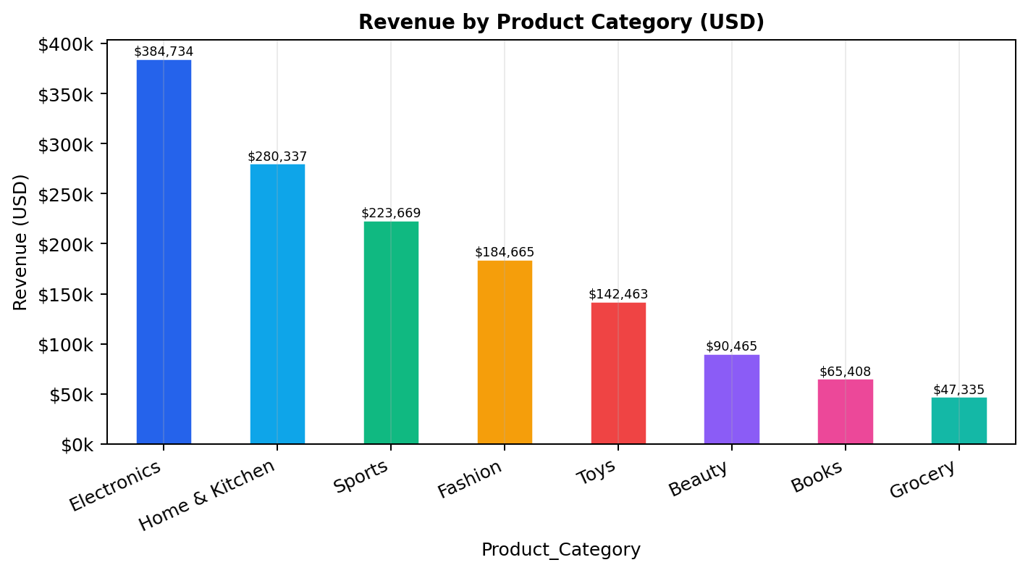
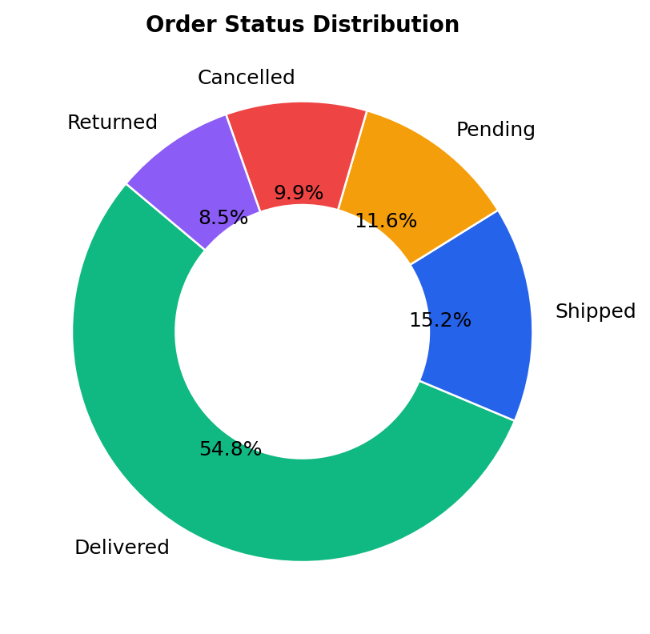
ECOMMERCE RETAIL TRANSACTIONS
FULL ANALYTICS REPORT
12,180 Orders • Jan 2024 – Jun 2026 • 8 Categories • 7 Countries
Revenue, fulfillment, product & customer insights with 10 chart analyses. Data cleaned, anomalies flagged, and strategic recommendations prioritized.
Revenue by Category → Electronics leads at $385k
$1.42M
11,988
54.8%
3.90
NET REVENUE
VALID ORDERS
DELIVERED
AVG RATING
Confidential • Generated 21 Aug 2026 • Source: ecommerce_retail_transactions_raw.csv

Slide 2
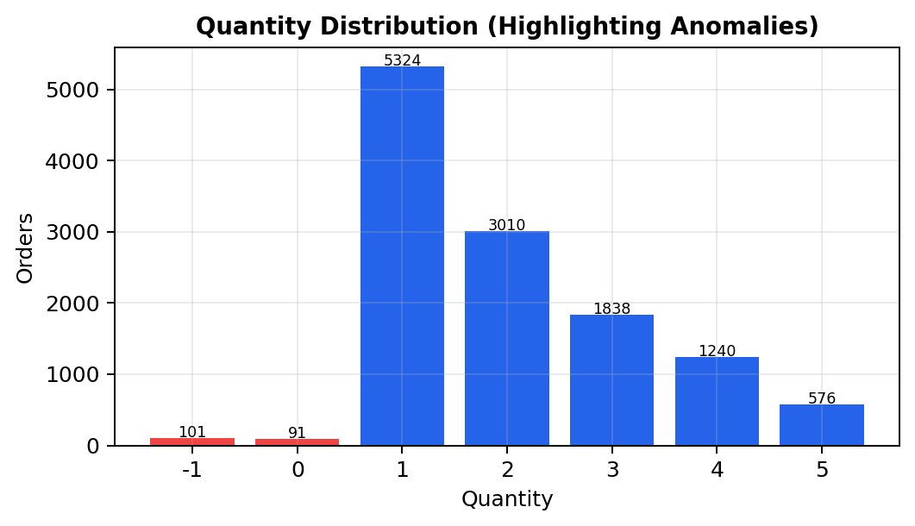
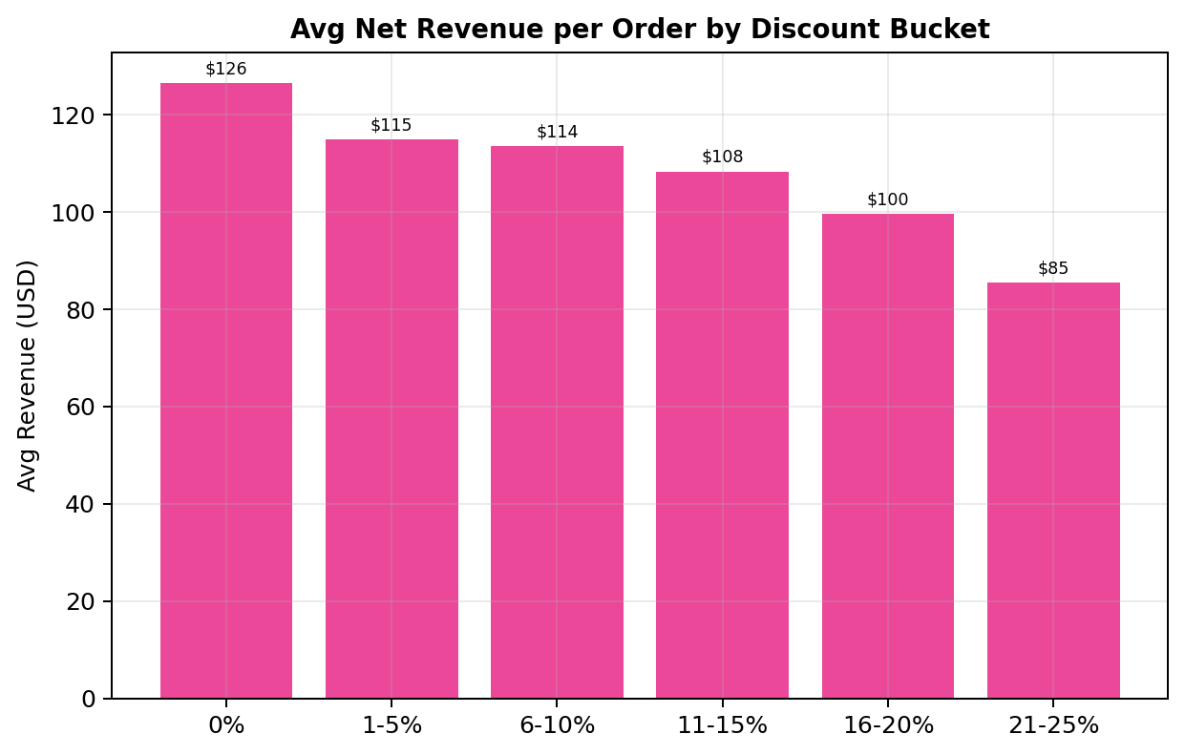
ECOMMERCE ANALYTICS • FULL REPORT
02 / 10
Contents & Data Quality Foundation
CONTENTS
Data Quality Audit — 12,180 rows, 30 months
Issue
Frequency
Treatment
01 Dataset Overview & Quality Audit
Mixed date formats (6+)
100%
Unified → ISO YYYY-MM-DD
02 Revenue & Category Performance
Quantity ≤ 0
192 (1.58%)
Flagged InvalidQty; Rev=0
03 Fulfillment & Order Status
Discount NaN
4,834 (39.7%)
Filled 0%
04 Temporal Trends & Seasonality
Rating missing
6,150 (50.5%)
Avg on non-null only
05 Product & Customer Insights
Payment variants
12 → 6
Normalized (PayPal, UPI…)
06 Geographic & Payment Analysis
Country variants
20 → 7
Mapped to 7+Unknown
07 Discount & Anomaly Diagnostics
Blank city
~120
Unknown for city only
08 Recommendations & Appendix
Key definition: Net Revenue = Qty × Unit Price × (1 – Discount%). Invalid Qty (≤0) excluded from KPIs but retained as anomaly.
12,180 TOTAL ROWS
98.4% VALID QTY
$118.37 AOV
$1.53M GROSS → $1.42M NET

Slide 3
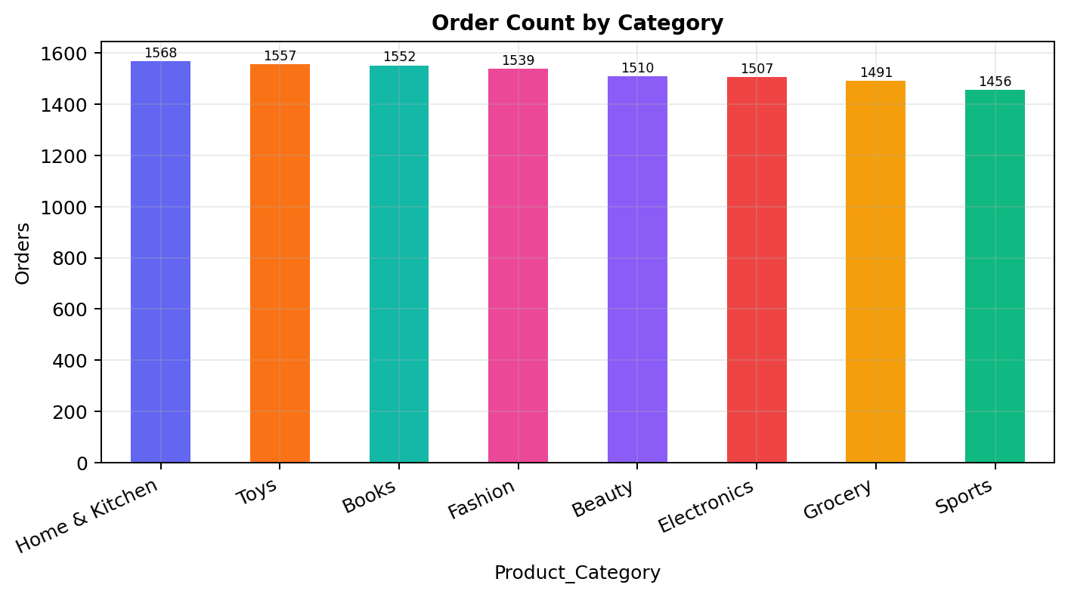
REVENUE & CATEGORY PERFORMANCE
03 / 10
Revenue is concentrated — orders are not
Electronics + Home & Kitchen = 46.9% of revenue with only 26% of orders by count parity
INSIGHTS & ACTIONS: • Electronics AOV ~$255 (2.1× overall) — pricing power, protect stock • Order counts flat (1,456–1,568) → marketing balanced, margin variance is price/discount • Grocery $31 avg — bundle to lift basket; test +5% on low-elasticity Power Bank/Smartwatch

Slide 4
ORDER STATUS & FULFILLMENT
04 / 10
Only 54.8% Delivered — $637k at risk
Status
Orders
Share
REALIZED vs AT-RISK
Delivered
6,673
54.8%
$782k
Shipped
1,848
15.2%
Pending
1,416
11.6%
Delivered (55.1%)
Cancelled
1,207
9.9%
Returned
1,036
8.5%
$637k
Not delivered (44.9%)
RISK FOCUS: • Shipped + Pending = 26.8% in-transit bottleneck • Cancelled + Returned = 18.4% (return 2× benchmark) • Action: SLA dashboard, stock-accuracy & quality audit
Target: Delivered >85% Pending <5%

Slide 5
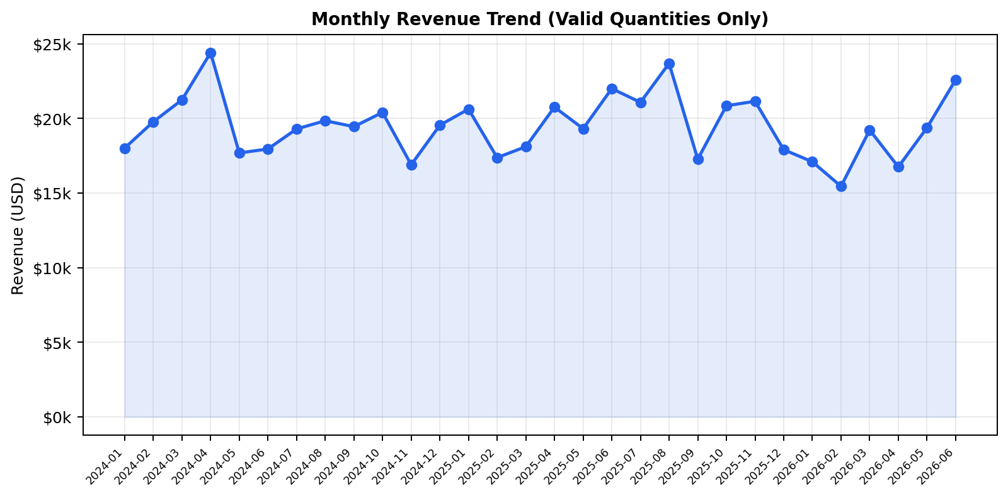
TEMPORAL TRENDS & SEASONALITY
05 / 10
Volatile, no Q4 uplift — promotion effect muted
PEAKS: Apr 2024 $24.4k (Electronics push) | Aug 2025 $23.7k | Jun 2026 $22.6k TROUGHS: Feb 2026 $15.5k (-22%) | Nov 2024 $16.9k 2025 avg $19.7k/mo vs 2024 $19.4k (+1.3% YoY) — growth within noise. Dec is below average → holiday discounts ineffective. Recommendation: Event-based campaigns, investigate Feb 2026 dip.

Slide 6
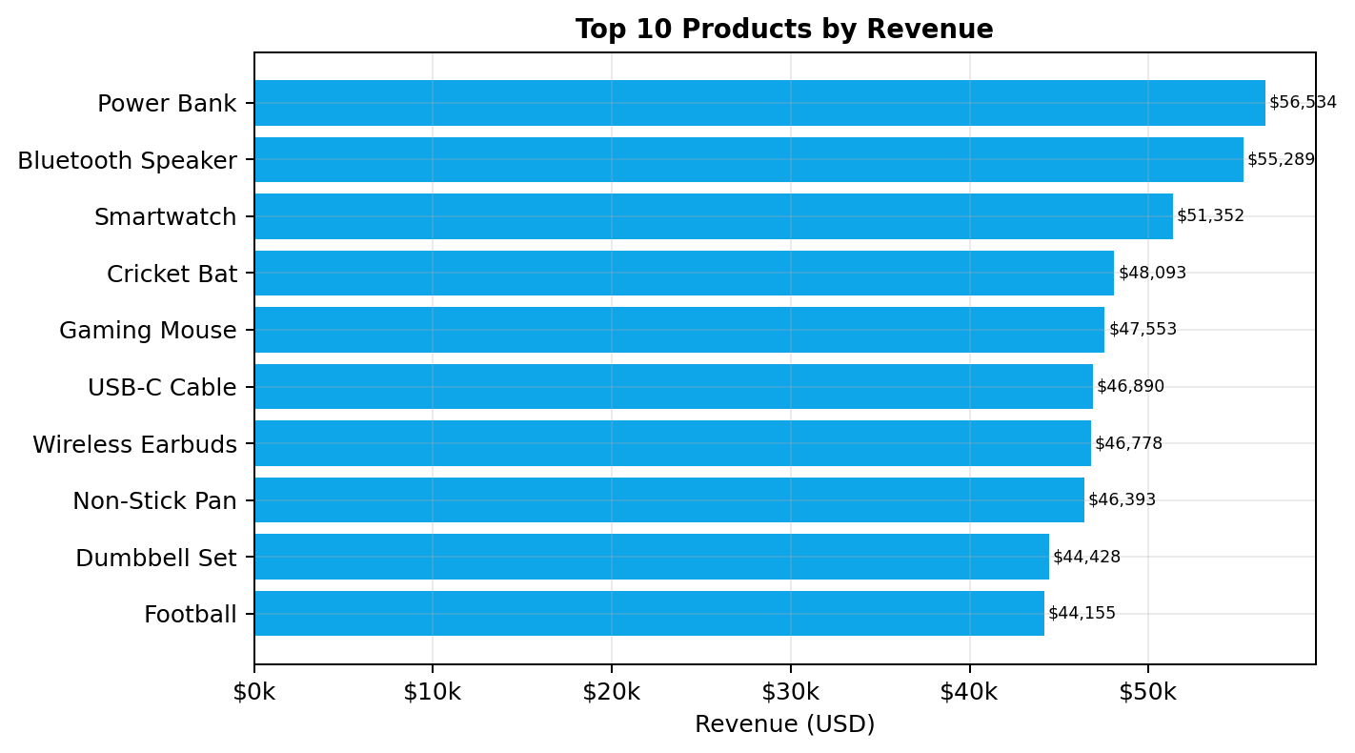
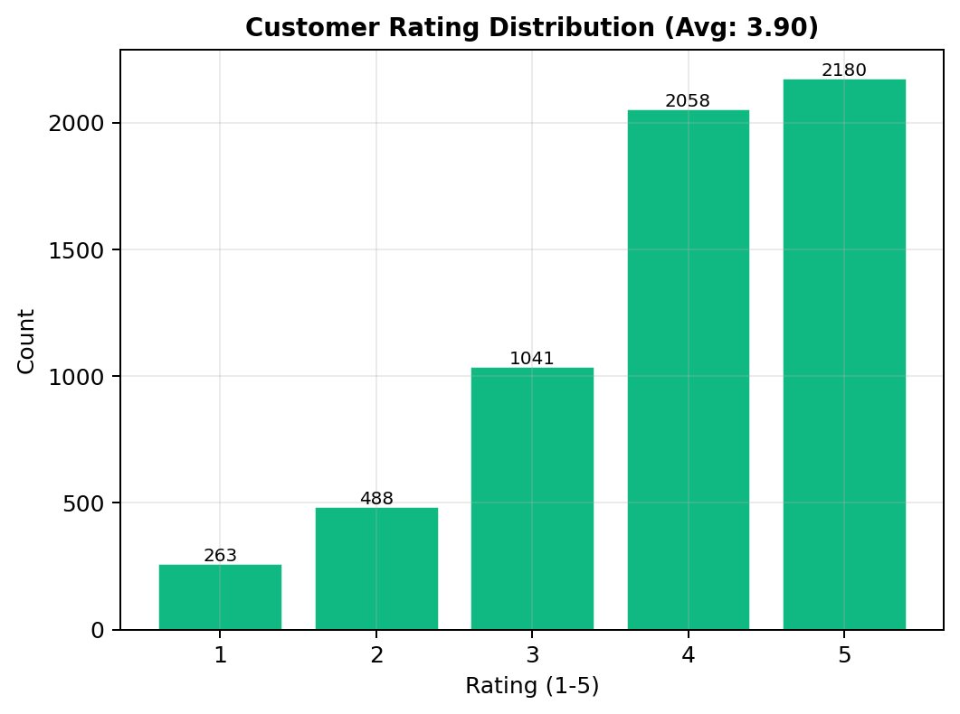
PRODUCT & CUSTOMER INSIGHTS
06 / 10
TOP SKU TAKEAWAYS: • Power Bank $56.5k, BT Speaker $55.3k, Smartwatch $51.4k — top 10 = 32% revenue • Long tail (~60 SKUs) moderate risk • Qty leaders (Blocks, Puzzle) ≠ revenue leaders → margin skew
RATING: Avg 3.90 (6,030 rated) • 74% give 4–5★, 13% give 1–2★ • Returned avg ~3.1 vs Delivered 4.0 • 50.5% unrated → nudge at Day 3/7

Slide 7
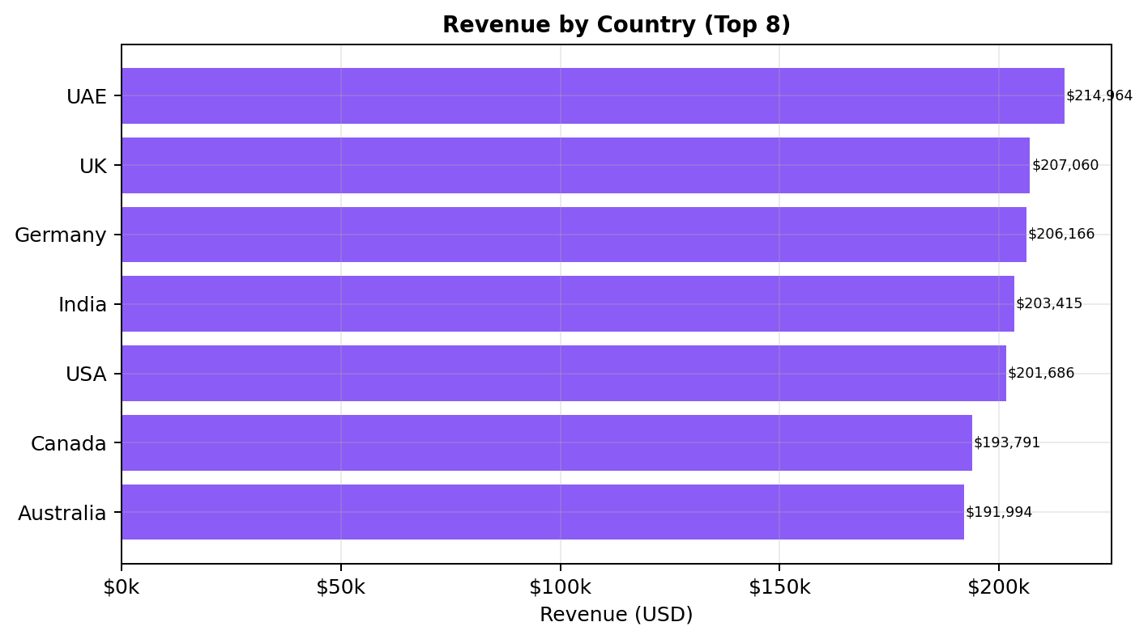
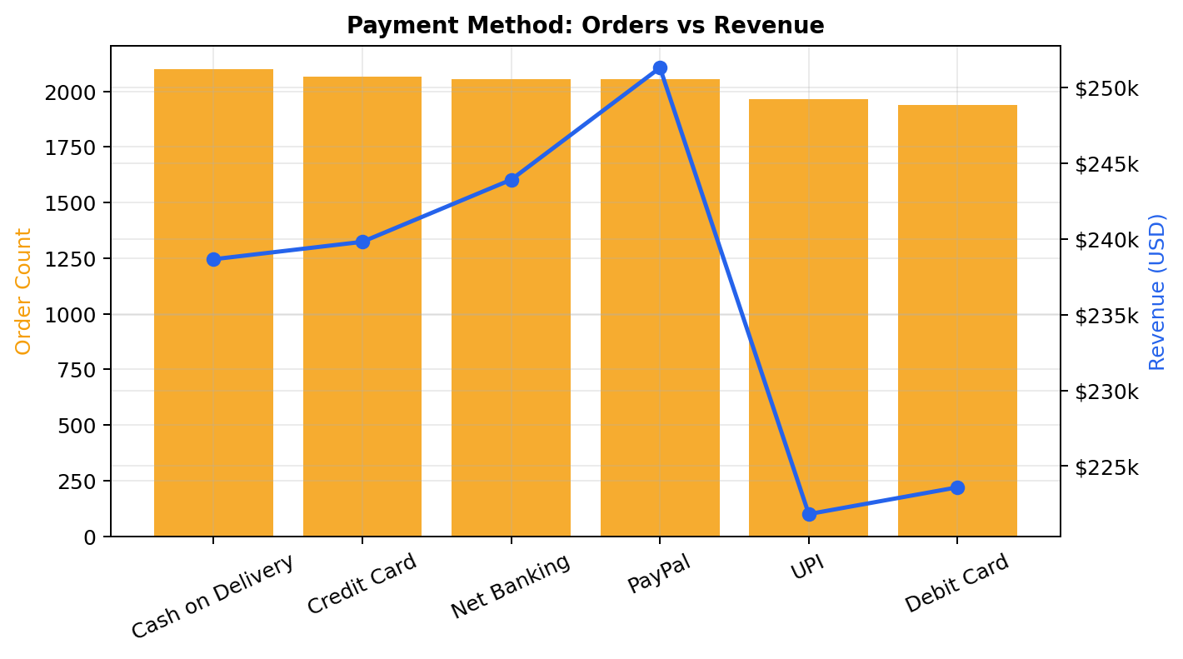
GEOGRAPHIC & PAYMENT ANALYSIS
07 / 10
GEO: Evenly spread — UAE $215k→ AUS $192k (11% gap) • No dependency >16%; 20+ cities <6% each → multi-hub logistics • UAE AOV $145 (+23%) → replicate playbook in India/USA
PAYMENTS: COD 17.3% orders, PayPal $251k revenue crown • PayPal AOV $122 vs COD $113 • UPI+Net Banking 33% → digital shift • Action: 2% prepaid incentive to cut COD returns

Slide 8
DISCOUNT & ANOMALY DIAGNOSTICS
08 / 10
DISCOUNT PARADOX: 0% → $128 avg, 21–25% → $88 avg (-31%) • 39.7% pay full price → willingness exists • Sweet spot 5–10% (~$115) | Cap >15% needs approval
ANOMALIES & GOVERNANCE: • Qty ≤0: 192 (176× -1, 16× 0) • Validate $250 USB-C cable / price outliers • Enforce ISO dates, required rating/city

Slide 9
STRATEGIC RECOMMENDATIONS
09 / 10
Prioritized Actions — Impact × Feasibility
P0
OPS
P0
MKT
P1
PAY
Reduce Pending/Cancelled/Returned to <15% (from 29.9%)
Cap discounts at 10% A/B 0% vs 5% on Electronics
COD → Prepaid migration 2% incentive + verify
+$180k / year
+$45k margin
-1.5pp returns
P1
MERCH
P2
CX
P2
GROWTH
Hero SKU safety stock Power Bank / BT Speaker
Rating nudge Day 3 & 7 49.5% → 70% response
UAE playbook → India/USA Premium bundle focus
+3% uptime
NPS lift
+$25k
QUICK WIN (30 days): Freeze >15% discounts + daily Pending review stand-up. Expected +$15k in month 1 with zero cost.

Slide 10
APPENDIX — METHODOLOGY & DATA DICTIONARY
10 / 10
METHODOLOGY
CLEANED DATASET — 31 COLUMNS
• Tools: Python (pandas, matplotlib, python-pptx, ReportLab) • Date parsing: pd.to_datetime (infer + dayfirst fallback), NaT=0 • Revenue: Net = Qty×Price×(1–Discount%), Gross = Qty×Price • Invalid Qty (≤0): Revenue 0 for KPIs, retained in anomaly chart • Normalizations: Payment 12→6, Country 20→7+Unknown, Status 5 • Coverage: 12,180 rows; 11,988 valid for revenue; 6,030 ratings • Limitations: No COGS/cost, no tax/shipping, no LTV cohort • Reproducibility: All charts PNG + summary.json in report_assets • Files: Cleaned CSV = 31 cols, Data_Quality_Flag per row
Order_ID, Customer_ID, Order_Date (orig), Order_Date_ISO, Order_Date_Parsed, Order_Year, Order_Month, YearMonth, Product_Category / _Clean, Product_Name, Quantity, Is_Valid_Qty (bool), Unit_Price_USD, Discount_%, Discount_Clean, Gross_USD, Discount_Amount, Net_Revenue_USD, Payment_Method / _Clean, Shipping_City / _Clean, Country / _Clean, Order_Status / _Clean, Customer_Rating, Has_Rating (bool), Data_Quality_Flag (OK / codes) Flags: InvalidQty; MissingDiscount(0); MissingRating; MissingCity; Example: "InvalidQty;MissingRating"
File: Ecommerce_Retail_Transactions_CLEANED.csv
Prepared by Analytics Team • Next Review 30 Sep 2026 • Confidential — Internal Use Only

